Slide 1

backyard berry
Team 2: The Berry Bunch
02/13/20

Slide 2
User Scenarios
[ ]
Registered User:
Access to a profile page
  Access to past logs/records of harvests
  Private Locations.
Data sharing
  “public” (for all eyes)
  “private” (for their eyes and the scientist’s eyes).
Access to map of available patches, a berry identification section, information on the fruit fly, a harvest form, and cultural uses of berries.
Unregistered Guest User:
Access to a map of available patches, a berry identification section, information on the fruit fly, a harvest form, and cultural uses of berries.

Slide 3
Application Users & Environment
Users
Foragers
Scientists
Tourists
Residents in the Great Lakes Region
Environments
On a laptop or phone
– at home, in a vehicle, in the woods
– Before or after a harvest
– Before or after looking for berries
– looking for a berry patch
– logging a berry patch
Example:
On your phone, in a vehicle headed back from a berry patch logging berries.
Notes:
Foragers – Those who pick berries at you-pick farms or wild berries in the Great Lakes Region
Scientists – Tara Bal, Angie Carter, Erika Hersch-Green
Tourists – people who have come to the Great Lakes Region and want to go berry picking
Residents in the Great Lakes Region who are not regular foragers, but would like to go berry picking on occasion

Slide 4
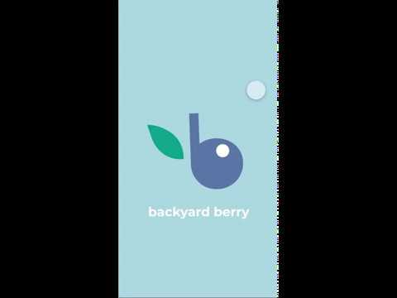
Prototype Demo

Slide 5
Workflow
This slideshow has a page-by-page flow. Each new page has a selection of buttons. Each of these buttons will be described. Then we move on to the next page in sequence and describe all of the buttons on that page. The figures of each page are labeled according to this order.
If you would like to follow a button selection path, you can select the in-slide hyper links to take you through that flow. This allows you to navigate the slides in the way a user might navigate the app.

Slide 6

Figure 0:
Logo page. Tap anywhere to continue.
Tap anywhere to continue

Slide 7
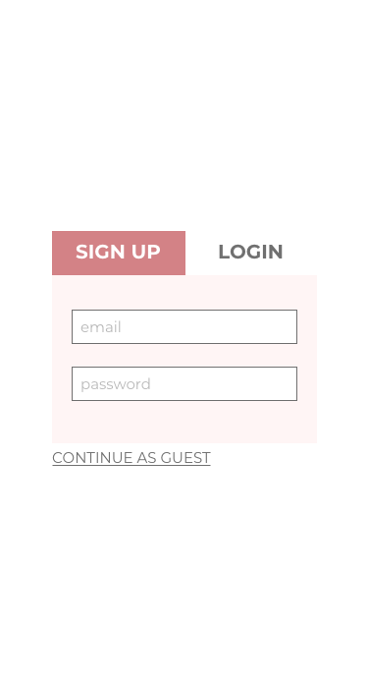
Figure 1:
This is the first thing a user would see when opening the app.
The user can choose to
Continue as a Guest
Create an Account
Login if they already have an account
If this is a scenario where the user does not have user credentials (first time user), they will enter in a new username and password into the “Sign Up” section.
This will take them to an information page that instructs all new users on how the app works. (As seen in Figure 3)
Submit

Slide 8
Figure 1.1:
If the username entered to create an account is not available, the text at the bottom will pop up.
Submit
Username not available

Slide 9
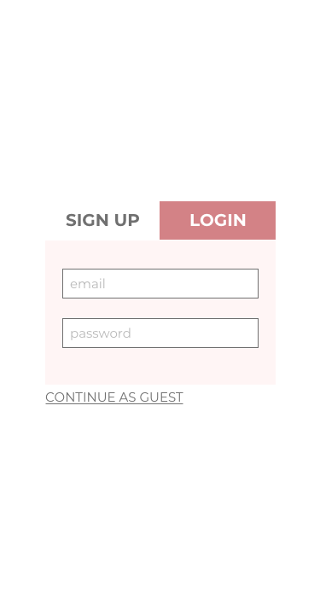
Figure 2:
In this image, the user already has an account. So, we will select the “Log In” option and enter our credentials.
This scenario does NOT produce the instruction manual seen in figure 3. It merely logs the user in and allows them access to exclusive features only for members of the app.
Submit

Slide 10
Figure 2.1:
The text at the bottom will pop up if the username and password entered do not match an entry in the database.
Submit
Username or Password Incorrect

Slide 11
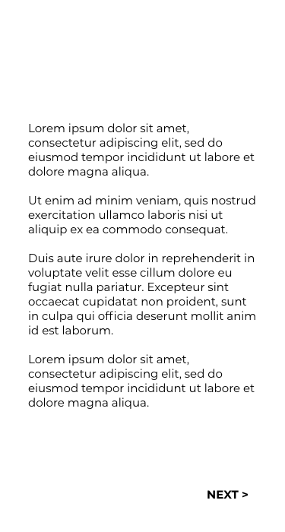
Figure 3:
When the user has finished creating an account (first time user), they are automatically directed to this view. It contains a brief introduction to the application and the purpose for data collection.
This will NOT show again for repeat logins, however it can be accessed again in the info page.
Hitting “NEXT” proceeds to the next tutorial page.

Slide 12
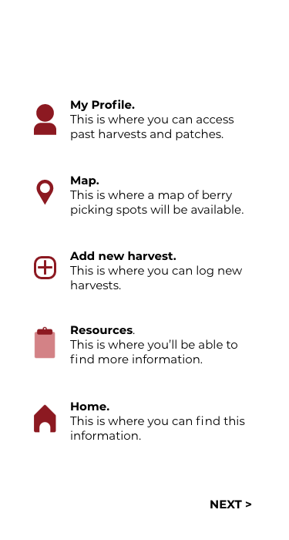
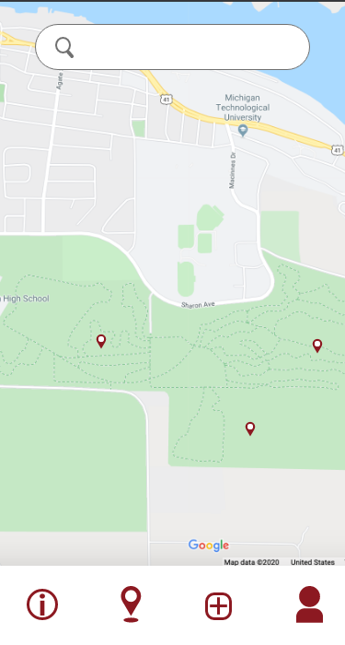
Figure 4:
Users see this view after they select “next” from Figure 3. It also serves as an introduction to the application.
Its purpose is to teach users about the different icons the application uses and what the mean in regards to using the application.
This view can also be accessed later in the info view.
“NEXT” proceeds to the home page if accessed for the first time on app startup or back to the information page if accessed from the information page.

Slide 13
Figure 5:
After the initial information, the user sees the map of berry harvests. They can search for locations and harvests at the top.
Tapping the map on an icon will show harvest info. Tapping the on the map where there isn’t an icon lets the user log a new harvest.
On the bottom are buttons with functionality described on the previous view (Figure 4).
takes you to the information page
represents the page you are on
takes you to the record harvest page
takes you to your profile page
tapping a harvest on the map opens a pop up
Show public harvests
Show private harvests
The boxes at the bottom let you toggle whether public and private harvests are shown

Slide 14
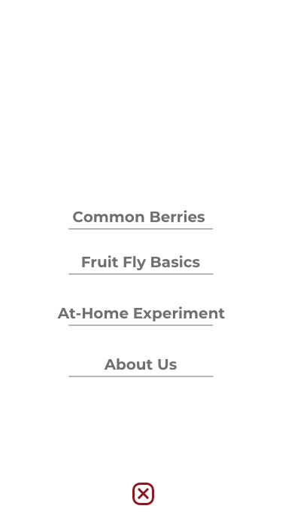
Figure 5.1:
If the user clicks on an existing harvest on the map, a pop up will appear that shows the harvest information.
will close the pop up.
Harvest Info
Date harvested:
mm/dd/yy
Berry type:
blueberry
Berry patch type:
wild
Berry patch location:
deciduous forest

Slide 15
“Data” is available only on scientist accounts and takes you to the scientist view
“App summary” pulls up the tutorial information
“Common Berries” pulls up the berry information page
“Fruit Fly Basics” pulls up the fruit fly information page
“At-Home Experiment” pulls up the fruit fly test page
“About Us” pulls up the about us page
returns the user to the map
Figure 6:
This pop-up appears when the user selects the “Information” button.
This page lets the user navigate to different instructional content in the app.
Data
App Summary

Slide 16
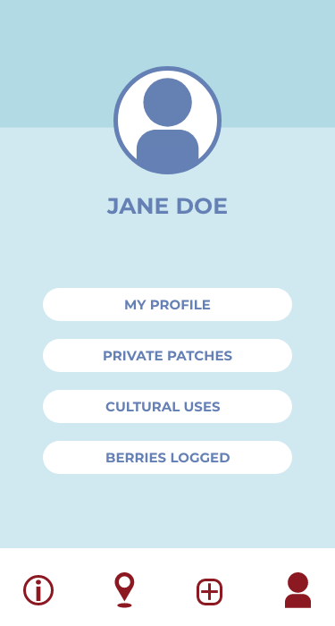

Figure 7:
This is the view that a user will see whenever they click on their profile button in the bottom right of the app.
“MY ACCOUNT” takes the user to the account page.
“DEMOGRAPHIC INFO” takes the user to the demographic info page.
takes you to the information page
takes you to the map page
takes you to the record harvest page
represents the page you are on
MY ACCOUNT
DEMOGRAPHIC INFO

Slide 17
Figure 7.1:
Hitting “CHANGE PASSWORD” pops up a box to change your password.
Hitting “DELETE ACCOUNT” creates a pop up asking you to confirm your decision.
returns the user to the profile page.
My Account
USERNAME: janedoe1
CHANGE PASSWORD
DELETE ACCOUNT

Slide 18
Figure 7.1.1:
The popup for changing your password.
“SUBMIT” and “CANCEL” close the popup.
My Account
USERNAME: janedoe1
Change password
Old password:
_____________________
New password:
_____________________
Confirm new password:
_____________________
CHANGE PASSWORD
DELETE ACCOUNT
SUBMIT
CANCEL

Slide 19
Figure 7.1.2:
The pop up for deleting your account.
“CONFIRM” returns the user to the login page.
“CANCEL” closes the popup.
My Account
USERNAME: janedoe1
Delete Account?
WARNING: this action cannot be undone
CHANGE PASSWORD
CONFIRM
CANCEL
DELETE ACCOUNT

Slide 20
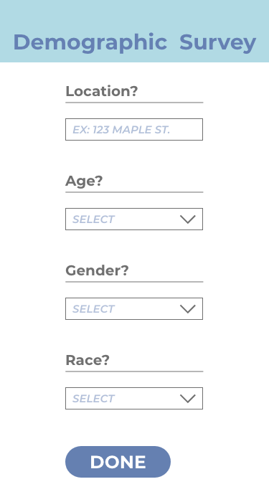
Age: _________
Gender:
  man
  woman
  non-binary
  prefer to self
  describe: _________
  prefer not to say
Race or ethnicity:
  White
  Hispanic or Latino
  Asian or Asian Indian
  Black or African American
  American Indian or Alaska Native
  Middle Eastern or North African
  Native Hawaiian or Pacific Islander
  Other: _________
Tribal member:
  yes
  no
What are your favorite berries to pick: _________
Info
Figure 8:
This is the Demographic Info view. It is an optional survey that users can access from their account view. The questions are shown to the right of the image.
This allows the scientists to collect data on who is picking berries.
The page will show previous responses.
“DONE” returns the user to the profile page.

Slide 21
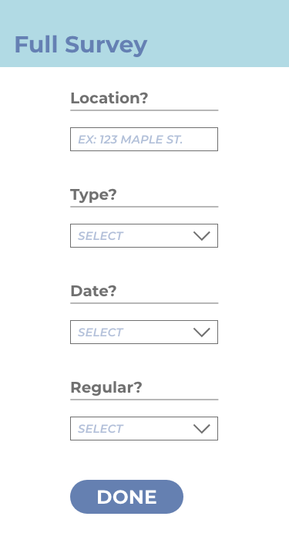
Figure 9:
This form will show after logging a berry harvest. This will ask questions about the specific harvest completed.
The questions can be seen in the next slide.
Harvest Questionnaire

Slide 22
Harvest Questionnaire
* = required field
* Where did you pick the berries?
  you-pick farm
  backyard/garden
  pine/conifer/softwood forest
  deciduous/hardwood forest
  grassy area/meadow
  roadside
  wetlands
  other: _________
* Have you heard of the Spotted Wing Drosophila (SWD) fruit fly?
  yes
  no
With whom did you pick the berries?
  by myself
  with family
  with friends
  other: _________
How do you plan to use the berries? (check all that apply)
  sell
  eat unprocessed
  process into other products (pies, jams, etc.)
  share/give away/gift
  freeze to eat or process later
  other: _________
Distance traveled to pick berries (in miles): _____
NEXT SLIDE
* Date: mm/dd/yy
* Type(s) of berries picked (check all that apply):
  raspberries
  blackberries
  blueberries
  cherries
  strawberries
  thimbleberries
  other: _________
* Were the berries you picked
  wild or natural
  planted grown of cultivated
* Approx. quantity of berries picked
(in cups): _________
* Location of berries
  use my current location
  choose location on map (this will pop up the map; you can tap the map to choose the location; it will ask you to confirm that you tapped the location you wanted; if yes, it will return to the form; if no, it will close the confirmation pop up and stay on the map)

Slide 23
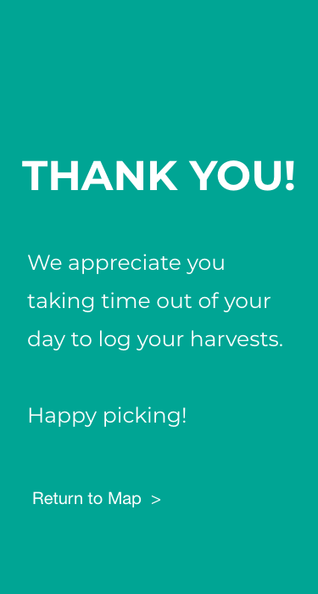
Figure 10:
This appears after the user logs a harvest.
“Return to map” returns the user to the map (main page).

Slide 24
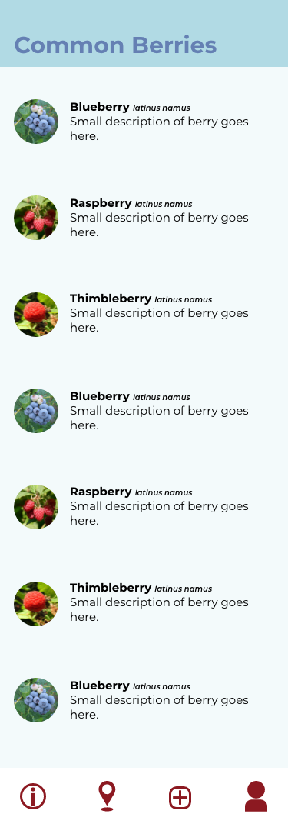
Figure 11:
This pop-up appears when the user selects “Common Berries” from the information menu in figure 6.
It is a scrollable database of berries common to the UP complete with pictures, latin nomenclature, etc.
returns the user to the information page

Slide 25
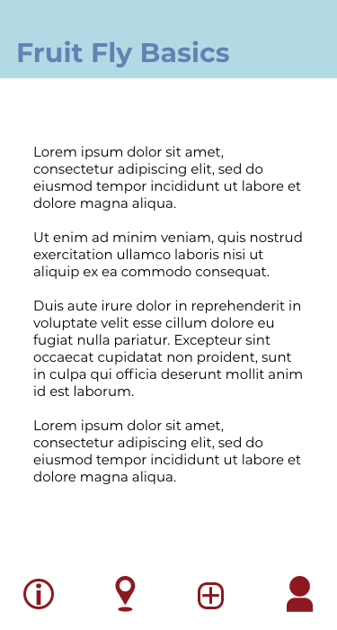

Figure 12
This pop-up appears when the user selects “Fruit Fly Basics” from the information menu in figure 6.
It gives information about the invasive fruit fly population.
The ‘Download’ button allows you to download a PDF of this info.
The ‘X’ shown at the bottom above the nav bar closes the pop-up.
returns the user to the information page

Slide 26
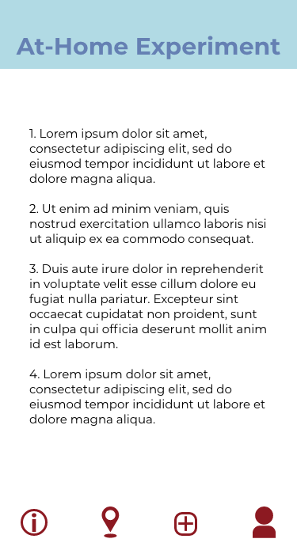
Figure 13:
This is the pop-up that appears when you select “At-Home Experiment” from the menu in figure 6.
This gives information on how to test at-home for traces of the invasive fruit fly species.
The ‘Download’ button allows you to download a PDF of this info.
The ‘X’ shown at the bottom above the nav bar closes the pop-up.
returns the user to the information page

Slide 27
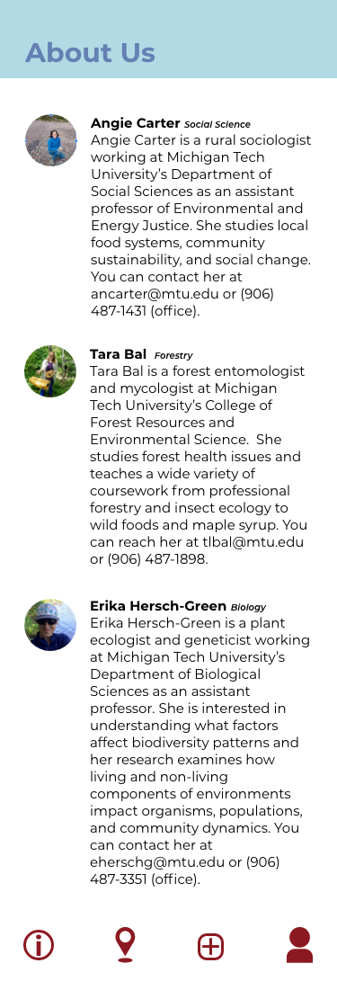
Figure 14:
This is the pop-up that appears when you select “At-Home Experiment” from the menu in figure 6.
This gives information on the scientists involved in the project
The ‘X’ shown at the bottom above the nav bar closes the pop-up.
returns the user to the information page

Slide 28

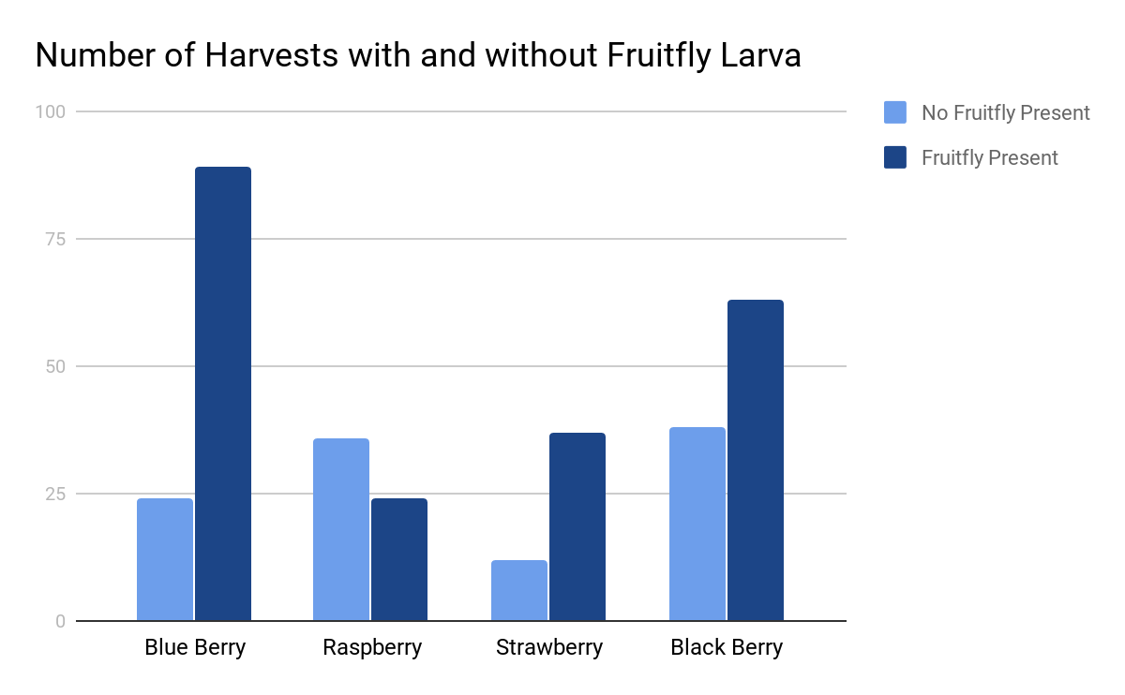
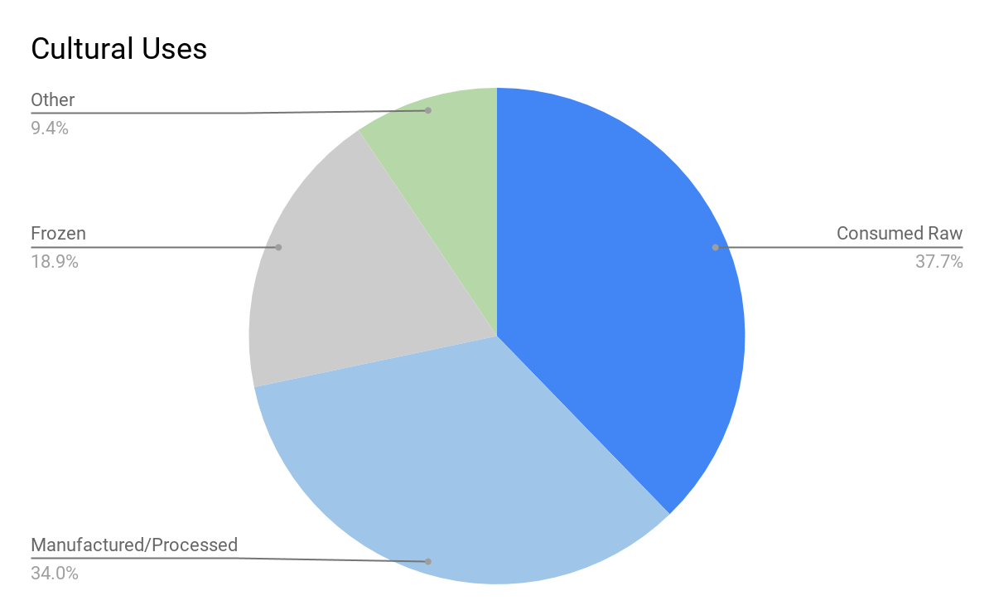
Figure 15: Scientist View. If a registered scientist logs in to the app they have access to a page depicting charted data taken from all of the user surveys. The scientists can use this information for their studies.
“Home” returns the user to the map page.
Home
Download Data
Log Out

Slide 29
Goals & Concerns
Concerns
Navigation
  Are the icons clear enough?
    Do they communicate what they need to?
  Should there be a home button?
  User profile?
Motivation
  Get the word out and recruit users
  Create a desire to use the app
Usability
  Is it user-friendly?
  Are instructions clear and where they need to be?
  Will text be readable?
Feasibility
  Is the project too complicated for the time frame?
Goals
Simple user-friendly interface
User-test with users outside of our generation
Create easy-to-understand Scientist Materials

Slide 30
Preliminary Instructional & Other Content
First-time user informational content
  App overview
  Icon descriptions
  Map use description
Berry information
  Common names
  Pictures
  Identifying features
At-home fruit-fly larvae test
“About Us” page
  Background information on the scientists

